Slide 1
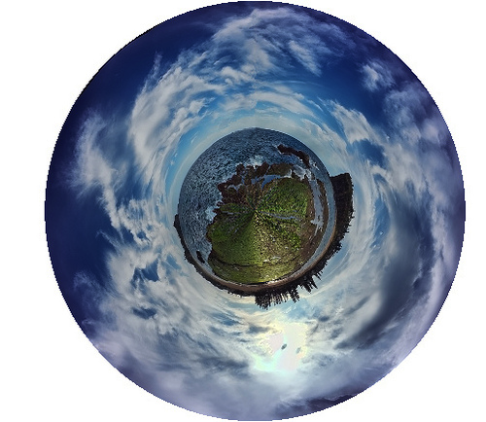
Connecting Career Education
and the Emerging Green Workforce
Laurie Maak, Co-Director
Joanne Martens, Co-Director
Tracy Ostrom, Skyline High School
Funded by

Slide 2
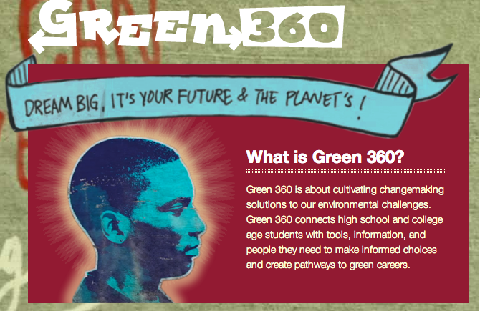
Exploring pathways to green careers
Green360careers.net

Slide 3
A 360 degree view of …
Environmental Sustainability
World of Work
Career Education
Green 360 makes Career Partnership Academy connections

Slide 4
Green 360 TIPs
Tools
Info
Choice
People
Students make informed choices and create pathways to green careers.

Slide 5
Step into Your Future
http://www.green360careers.net/program

Slide 6
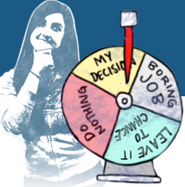
Career Catalyst
Jump start career exploration!
Discover Interests
Explore Jobs
Private Locker
Lesson Plans
“I learned that my career can be a green career. I learned that I can follow my dreams and still make a difference.” High school student
Green360careers.net/catalyst

Slide 7
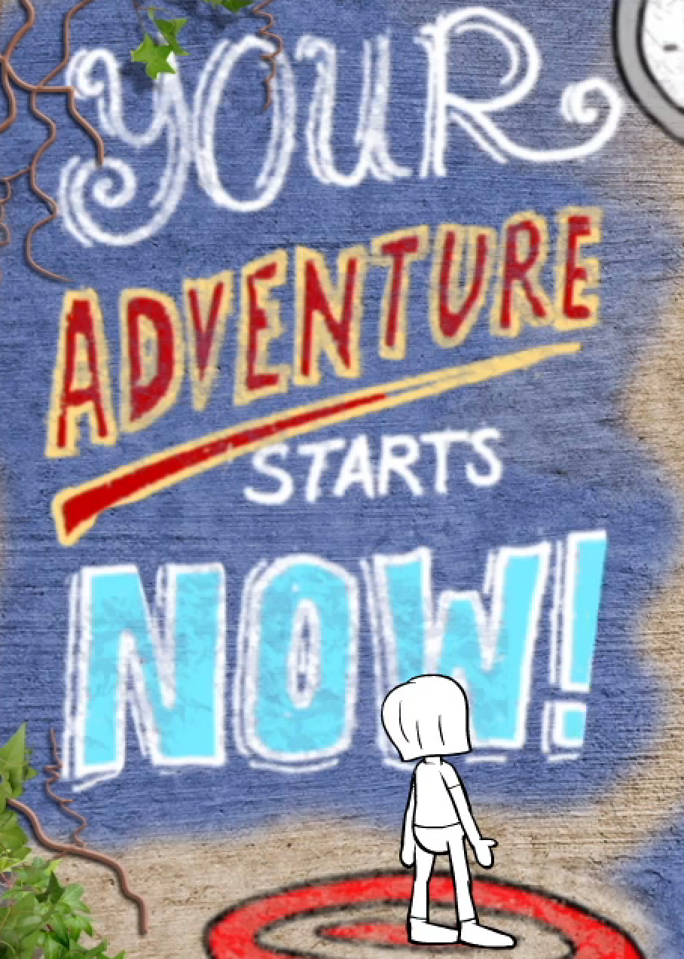
Online Course
Career 101
Environmental Sustainability
Career Strategies
Final Project
“This course was the first step for me to look into my future career possibilities. It sparked my interest in a green career for the first time.”
High School Student
Green360careers.net/course

Slide 8
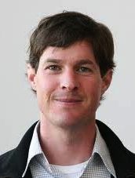
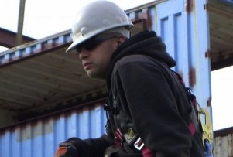
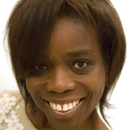
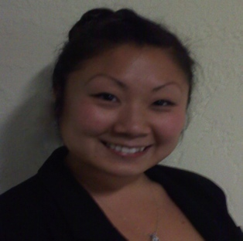
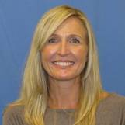
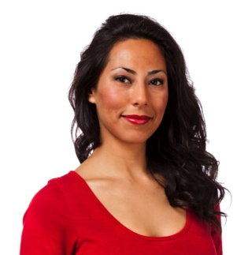
Community…
Environmental Sustainability
10 Challenges
World of Work
Gurus
Changemakers
Career Education
Career Coaches

Slide 9
Use Cases
Catalyst | Course | Community
-Career exploration -Career days -Internship search -CPA recruitment | -Post AP testing -Career Readiness -Cross-Curricular Projects -Interview Skills -Mentor Development (juniors) -Senior internships -College applications | -Augments career conversations -Showcase student or group projects -Partnerships with organizations

Slide 10
Green 360 Resources
 | Catalyst | Course | Community
Grade Level | 8th grade on | 10th-12th grade | -8th grade on
Class Periods | -1-3 class periods - Home -Independently | 12-15 class periods | Flexible
Technology | -Each user needs computer & internet -School or home | -Each user needs computer and internet -Teacher lead: one set-up | -Computer & internet -School or home
Preparation | 30 mins to complete & review lesson plan | 4 hrs course review & set-up | 15 mins to review resources

Slide 11
Teachers Support
Startup strategies
Customize course
Facilitation Tips
Peer-to-peer discussions
Resource sharing

Slide 12
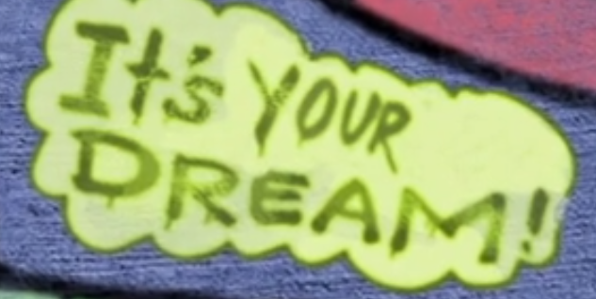
What’s on your mind?
Thank you for your interest!

Slide 13
Contact Information
Laurie Maak, WestEd
lmaak@wested.org
510-520-4658
Joanne Martens, The Intelleto Advantage
joanne@green360careers.net
408-691-5678
green360careers.net

